Slide 1





04.05.23 Credenciales_AINDA-ENG

Slide 2
Disclaimer
The information contained in this document is indicative and not exhaustive and belongs to Ainda Energia & Infraestructura S.A.P.I. de C.V., ("AINDA" or the "Company"). This material has been prepared by AINDA based on public information, or on information prepared by the Company, for informational purposes only and confidentially addressed to a limited number of people. Although the information included in this presentation has been obtained from sources that AINDA considers reliable, it is not responsible for its accuracy, validity, timeliness or completeness for any purpose. No representation or warranty is given, either express or implied, nor shall it depend on the accuracy, completeness or accuracy of the information and opinions contained herein.
This presentation and the information contained in it may contain private, secret, confidential and commercially sensitive information, so it must be considered as confidential for all legal purposes that may arise and people who have access to such information must keep absolute confidentiality against third parties, being obliged not to copy, disclose or reveal in any way the content or scope of such information, unless otherwise authorized in writing by AINDA.
Any person interested in the content of this presentation should consult and read in full the preliminary prospectus and the documents of the issue, before acquiring or selling securities, or make investment decisions in relation to the securities described in this presentation.
Neither this document nor its content constitute an offer, invitation or request to purchase, subscribe, place or ensure securities or other instruments or realization or cancellation of investments, nor can they serve as the basis for any contract, commitment or decision. of any kind.
An investor who has access to this presentation recognizes that the securities, instruments or investments referred to may not be suitable for their specific investment objectives, financial position or risk profile, since they have not been taken into consideration for the preparation of this document, so the investor must adopt its own investment decisions considering these circumstances and seeking specific and specialized advice that may be necessary. Any decision made based on the information contained herein will be at its own risk.
No part of this document may be reproduced, taken away or transmitted to those countries (or persons or entities thereof) in which the distribution may be prohibited by the applicable regulations. Failure to comply with these restrictions may constitute an infringement of the legislation of the corresponding jurisdiction.
The recipients of this presentation should not interpret the content thereof as legal, tax or investment advice, so they should consult their own advisors for that purpose.
Any projections contained herein were prepared based on the views of AINDA as of the date of this presentation regarding future events and financial performance, and various estimates and assumptions, including estimates and assumptions related to future events, and may be incorrect or may change from time to time. The projections have been prepared and have a merely illustrative purpose, and do not constitute a prognosis. They have been prepared based on the current perspective of AINDA in relation to future events and various estimates and assumptions made by AINDA, including estimates and assumptions regarding events that have not occurred, which may be incorrect. Although the projections are based on assumptions that AINDA considers reasonable under the circumstances, they are subject to uncertainties, changes (including changes in economic, operational, political, legal or other circumstances) and other risks, including, but not limited to, general financial and business trends, as well as legislation that affects the legal provisions on banking and securities, monetary and fiscal policies, exchange rates, interest rates, inflation, and market conditions, which are beyond control of AINDA. No person assures or grants representation, or guarantee that the projections will be reached, and no recipient should depend on them. Neither AINDA, nor its affiliates, or its directors, officers, employees, partners or shareholders, advisors or agents assure or grant representation or guarantee with respect to the accuracy of the projections. Nothing contained in this presentation may be considered as a guarantee, promise, forecast or representation for the future. AINDA does not assume any obligation to update the projections, or any information contained in this presentation.
This presentation and its contents are property of the Company and may not be reproduced or disseminated in whole or in parts without the prior written consent of AINDA.
Neither the CNBV nor any other authority has approved or disapproved the information contained in this presentation, as well as its veracity and sufficiency.

Slide 3
SECTION I
Team and Corporate Governance

Slide 4
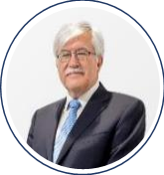
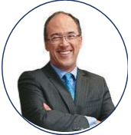
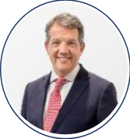
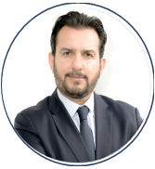

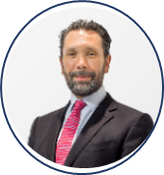
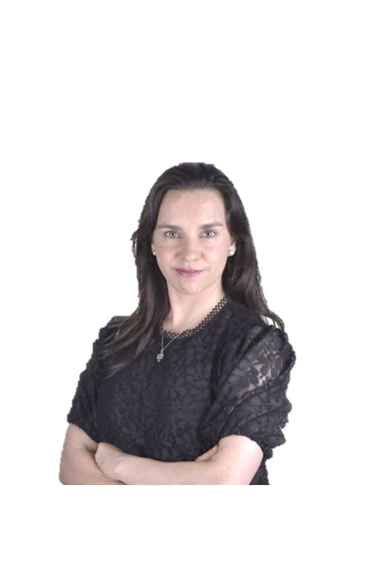
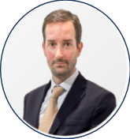
















Consolidated executive team with extensive experience
AINDA has consolidated its executive team through its ability to attract talent with extensive experience.
Executive
Co-Chairman
Executive
Co-Chairman
Chief Executive
Officer
Chief Investments
Officer
Chief Financial
Officer
Executive Director of Asset Mgmt and ESG
Legal and Compliance Director
Analysis
Director
Engineering Director
Oscar de Buen Richkarday | Juan Carlos Echeverry Garzón | Manuel Rodríguez Arregui | Gabriel Cerdio Gudiño | Tessy Rivera Cervera | José Pablo Rinkenbach Lizárraga | Diana González Flores | Andrés Castillo Arce | Douglas Palm Malpica
29 years of experience in infrastructure Infrastructure Undersecretary, Ministry of Communications and Transportation Advisor, GBM Infraestructura President, World Road Association Board of Governors, UNAM Key Man in Fund II | 12 years of experience in energy & infra Founder, EConcept CEO, Ecopetrol Minister of Finance, COL Director, National Planning Department, COL Dean of the Faculty of Economics, Universidad de los Andes | 28 years of experience in energy & infra CEO, GBM Infraestructura CAO, Ministry of the Interior Transportation Undersecretary, Ministry of Communications and Transportation MD LatAm, Oliver Wyman Key Man in Fund II | 22 years of experience in energy & infra Executive Director, GE Oil & Gas Corporate Business Development Director, GE Investment Director, GE Capital Real Estate Principal, Oliver Wyman Mentor, New Ventures Key Man in Fund II | 18 years of experience in energy & infra MD Energy & Project Finance, Evercore Partners VP Energy & Project Finance, Evercore Partners Consultant, The Boston Consulting Group Associate, Protego Key Man in Fund II | 22 years of experience in energy & infra Founder and partner, AINDA Consultores Principal, Oliver Wyman Co-founder, México Actúa Coordinator, Diploma on Energy Investments, ITAM | 17 years of experience in energy & infra Senior Associate, Galicia Abogados Senior Associate, White & Case MBA, IE Business School Secretary of the Board of Directors, AINDA | 19 years of experience in energy & infra Manager, Schlumberger Business Consulting Manager, McKinsey & Company Consultant, Oliver Wyman Board member, Museo del Papalote | 49 years of experience in energy & infra Consultant/ Technical Advisor, CBM Ingeniería Deputy Director of the Eastern Division, Petróleos de Venezuela Technical Support Committee for Human Resources Management, PDVSA

Slide 5
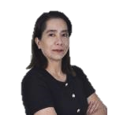

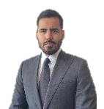

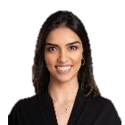
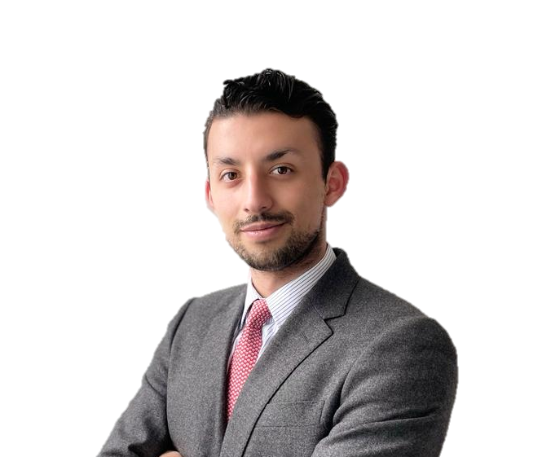

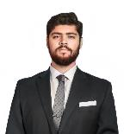



Strong professional team
AINDA has a diverse staff and with the technical experience to support during the investment process.
A&C
Director
Associate
Associate
Legal Associate
Analyst
Intern
Intern
Legal Intern
Karla Guevara Rico | Alejandra García Huitrón | Sergio Nahum Luja Acosta | Imelsy Miranda Infante | Jareny López López | Emilio Santiago Hernández Lazcano | Marijose Vázquez Muños | Victor Gómez Gerala
CFO, Altor Capital I Treasurer and Head of Investor Relations, Discovery Americas Derivative Rate Trader, NAFIN International Markets Associate, NAFIN $MXN futures and forwards trader, NAFIN Master in Finance, ITAM Public accountant, ITAM | Senior consultant, AINDA Consultores Head of Statistics Department, Ministry of Finance of the State of Puebla Degree in Actuary, UDLAP | Senior Investment Analyst, Engie SA Investment Banking Analyst, Vector Casa de Bolsa Research assistant, Instituto Mexicano del Petróleo CFA Level 2 Candidate Degree in Finance, ITAM | Legal analyst, AINDA Intern in corporate and financial law, Creel Abogados, S.C. Volunteer in Best Buddies Mexico program Law Degree, IBERO | Financial Analyst, Main Capital Financial Analyst, Trouver Capital Coordinator and volunteer, educational program “Enlace Rural” CFA level 1 Degree in finance, ITAM | Studying a degree in Financial Administration by the Tecnológico de Monterrey, with a focus on alternative assets and investment. Financial advisory, Servicios Profesionales GISnet | Studying a degree in Economics by the Instituto Tecnológico Autónomo de México. Recipient of the MIPI scholarship, which seeks to achieve equal participation of women leaders in ITAM. | Studying a degree in Law by the Universidad Lasalle Legal intern, Ríos Espinosa Abogados S.C. Legal intern, Bufete Odriozola S.C.

Slide 6


Robust Organizational Structure
AINDA has a team of experienced industry professionals to ensure successful Project development and execution.
Back office
Oscar
de Buen
Juan Carlos Echeverry*
Executive Co-President
Executive Co-President
Manuel
Rodríguez Arregui
Treasury - control and execution of banking transactions
Accounting - elaboration, administration and control of accounting processes
Tax - tax compliance. Calculation and filing of tax returns
Reporting and compliance to BMV, including filing information in accordance with CKD provisions
Payroll - calculation and payment management (taxes, IMSS, Afore, others), issuance of receipts, notifications
CEO
Jose Pablo Rinkenbach
Gabriel
Cerdio
Tessy
Rivera
Executive Director of Asset Mgmt and ESG
Chief Investment Officer
Chief Financial Officer
Diana González
Andrés
Castillo
Douglas
Palm
Karla
Guevara
Legal and Compliance Officer
Analysis Director
Engineering Director
A&C Director
Imelsy
Miranda
Sergio
Luja
Alejandra García
Mauricio
Mejía
Legal Associate
Associate
Associate
IT Manager
Victor
Gómez
Jareny
López
Emilio
Hernández
Marijose
Vázquez
Legal Intern
Analyst
Intern
Intern
*Incorporation into AINDA’s team after the placement of Fund ll .
Notes:
Preguntar sobre enero

Slide 7




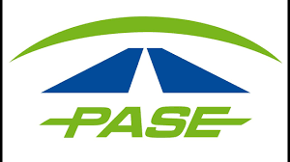












Combined team’s experience
AINDA has an experienced team in structuring and designing strategies in the energy and infrastructure sectors in LatAm.
Sector
Transportation and mobility
Water
Power
O&G
Private Equity
transactions
US$133.2MM
US$81.8MM
US$88.2MM
US$50.6MM
Roads
Water Systems
Renewables
Upstream
+20
PPP road projects - comprehensive development and structuring
Purchase, turnaround, debt issuance, and renegotiation of Cancun’s water concession:
3 municipalities
+1 million customers
+329 thousand water valves
+608
MW
Acquisition / sale, structuring and financing:
+402MWs wind projects
+206MWs solar projects
+240
fields
In depth analysis of fields during Ronda 1, Ronda 2, Ronda 3 and farmouts
FONADIN highways – management and supervision
+3,200 kms
4
migrations
Convencional
Oil and gas service contracts.
Design of the G1 concession model in COL
O&G opening strategy design
Economic – Technical Simulator, PEMEX
Ecopetrol transformation
Transactions and projects’ description
Airports and Ports
Acquisition of concessions in CDMX:
8 counties
+1 million customers
+205 thousand water valves
+392
MW
Acquisition / sale,
structuring and financing.
5
Airports in Mexico – strategy design, privatization, construction, and setup
Bogota's El Dorado and Cali’s International Terminal, Colombia
Development and expansion, Port of Manzanillo, Mexico
Administrative, operational, and technical diagnosis for an integral water, drainage, and sanitation system
5 municipalities
+500 thousand users
Other
Midstream & downstream
US$760MM
Structuring and execution of Fibra E
Optimization of Madero dry dock (Pemex)
Commercial vision and strategy for PEMEX Refinación.
Strategy for the opening of the electricity sector in Mx
Strategy and creation of the wholesale market
Self-generation projects in hydrocarbon fields in COL
Mobility
3
refineries
REFICAR y BARRANCABERMEJA in Colombia; TALARA in Perú
Mobility and safety solutions in Mx and COL.
Design of the Transmilenio transportation system, Bogotá
Settlement of the Tibitoc concession (one of the two water sources of the city of Bogotá)
  Pipelines: Bicentennial bidirectionality, Colombia
Clients, partners and projects

Slide 8

Governing Bodies
AINDA has a Corporate Governance to carry out responsible investments (ESG) since it helps to analyze and identify risks and opportunities with high growth potential, as well as ensure compliance with commitments and the attraction and development of talent.
Board of Directors
Technical Committee
Óscar de Buen Richkarday
Juan Carlos Zambrano B
Eduardo Barreda Cantú
Manuel Rodríguez Arregui
Gabriel Cerdio Gudiño
José P. Rinkenbach L
Leonardo Rinkenbach L
Tessy Rivera Cervera
Fernando Gómez Mont (Presidente)
Enrique Barón Crespo
Ginger Evans
Louis Ranger
Raúl A. Livas
Guillermo Guerrero Villalobos
Jose Oliver Venegas
Óscar de Buen Richkarday
Manuel Rodríguez Arregui
Gabriel Cerdio Gudiño
José P. Rinkenbach L
Investment Committee
Compensation Committee
Audit Committee
Details in the following slide
Juan Carlos Zambrano B
José P. Rinkenbach L.
Antonio Moya- Angeler
Manuel Rodríguez Arregui
Eduardo Barreda Cantú
Gabriel Cerdio Gudiño
Leonardo Rinkenbach L.
Tessy Rivera Cervera
Jorge Avalos Carpinteyro
Independent Member
Proeza Representative

Slide 9
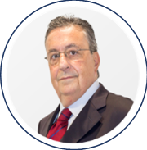

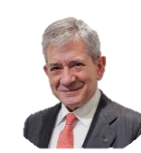

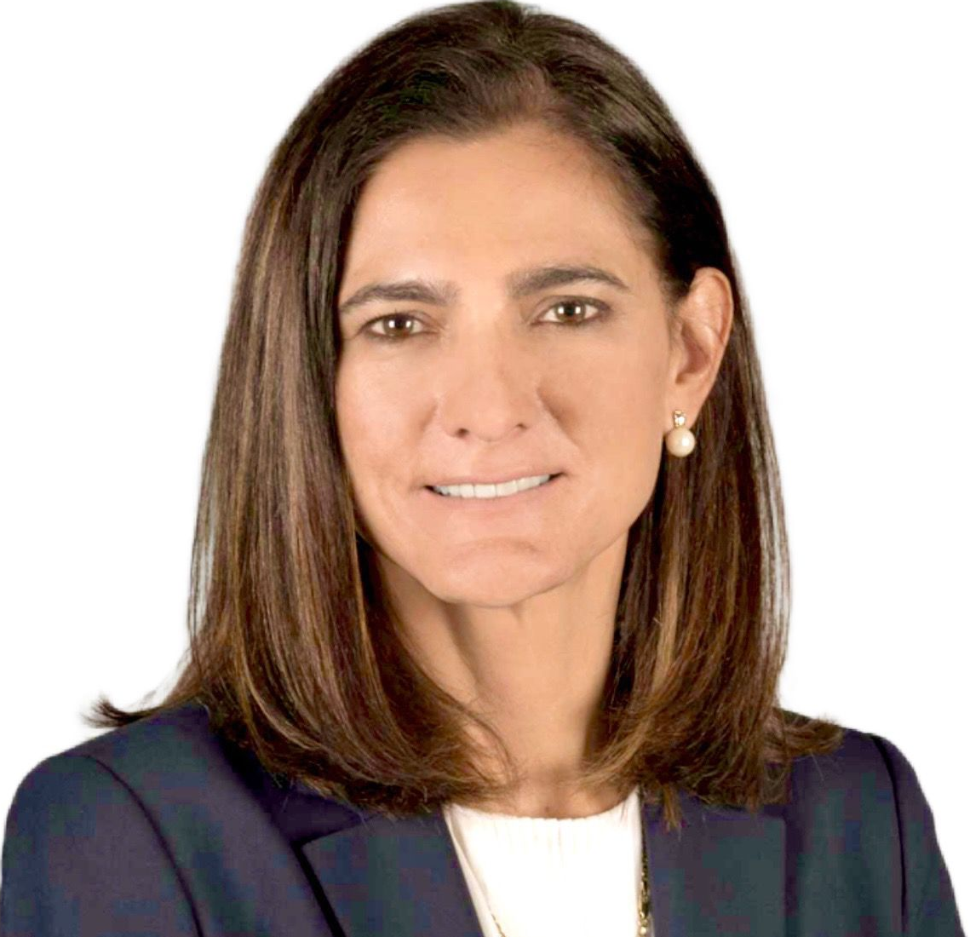

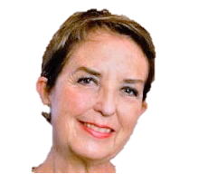

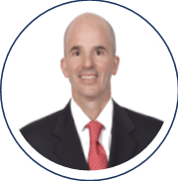
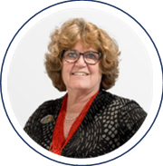
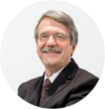


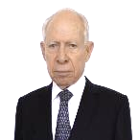
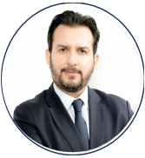

Investment and Technical Committees – Independent members
AINDA has incorporated independent members, with extensive experience in Mexico, Colombia, Chile, Europe, USA and Canada, in both the public and private sectors, who contribute to a rigorous decision-making process.
Independent Members
AINDA
AINDA
Oscar de Buen*
Fernando Gómez-Mont*
Enrique Barón Crespo*
Angela María Orozco
Gloria Hutt Hesse
Minister of the Interior
Partner, Zinser, Esponda
and Gomez-Mont
President, European Parliament
Minister of Transportation, Tourism
and Communications
Minister of Transportation
CEO and Partner, Research & Opportunities
Minister of Transport
and Telecommunications
Steer Davies Gleave, LatAm Director
Juan Carlos Echeverry
Manuel Rodríguez Arregui*
José Antonio González Anaya*
Ginger Evans*
Guillermo Guerrero Villalobos*
Louis Ranger*
CEO IZZI
Minister of Finance
CEO, PEMEX
CSO, CAG Holdings, a Carlyle Company
DC&O Director, Denver Airport
CEO, Chicago O’Hare Airport
CEO, CFE & LyFC
Head, CONAGUA
CEO, DIRAC
Vice Minister of Transportation,
Infrastructure and Communities
Corporate Director, OAG
Gabriel Cerdio*
* Currently participate as members of Investment and/or Technical Committee in AINDACK18 Fund
Tessy Rivera *
Notes:
Titulo

Slide 10
SECTION II
ESG leadership

Slide 11






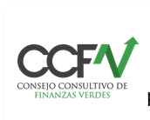
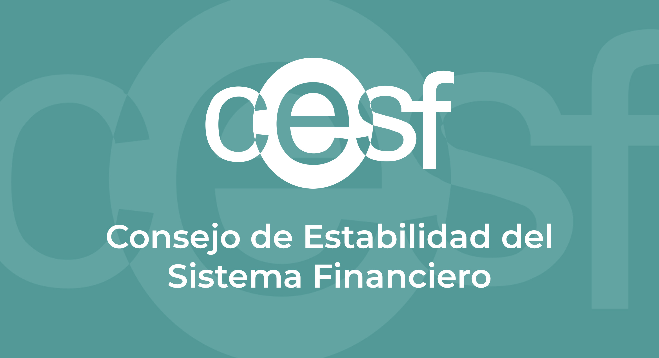





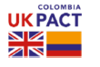

ESG at AINDA
AINDA has developed an ESG strategy based on solid corporate governance, from which it designs and implements a responsible and sustainable investment process with positive environmental and social impact.
Governance bodies
Policies and Processes
Assessment
AINDA’s Engagement
Governance bodies comprised by independent members with strong reputation
Board of Directors
Investment / Technical Committees
Audit Committee¹
Compensation & Development Committee²
The Audit Committee is responsible for compliance with policies and processes for adequate risk management and oversees ESG compliance
Ranked #1 LatAm and #3 worldwide of funds assessed
As member of the Board of Trustees, we help to:
Create awareness and educate citizens and visitors on the intrinsic value of biodiversity
Communicate the importance of limiting global warming and ways to mitigate it
Materiality Assessment
Code of Conduct and Ethics
Responsible Investment Policy
ESG at the Investment Process level
Diversity and Inclusion Policy
Cybersecurity Policy
Suppliers Policy
Risk and Investment Manual
5/5 stars in the Infrastructure module and 4/5 stars in the Investment & Stewardship Policy module in the principles of responsible investment of the UN
Investment process and incentive
alignment
The Fund supports the following causes:
Awards academic scholarships to outstanding female students from ITAM (leading college in Mx)
Seeks equal participation of leading females
Offers leadership programs to female students
Partnership model
Allows employees to acquire shares of the GP and have access to carried interest; the partnership vehicle may not have less than 40% participation in the entire GP
ESG Manager
Dedicates at least 40% of its time to carrying ESG-related functions
Compensation linked to ESG performance
Awarded for a second time in a row “Investor that best adheres to ESG factors in LATAM”
AINDA's CEO is an independent board member of Megaflux, LatAm's first last-mile electric vehicle startup
Participation in Organizations
Members of the Executive Team are part of:
Climate Risk - TCFD
UNPRI and GRESB Standards Committees
CCFV Working Group 4
CCFV representation in CESF
Amexcap’s Board and ESG Committee
With the support of CCADI³, AINDA has built a roadmap to implement TCFD⁴ recommendations regarding the analysis and monitoring of climate risks
Independent member: Jorge Ávalos Carpinteyro (CEO Fibra Monterrey)
Independent member: Antonio Moya-Angeler (Managing Director, Advent International)
Colombian Climate Asset Disclosure Initiative
The Financial Stability Board created the Task Force on Climate-related Financial Disclosures (TCFD) to improve and enhance climate-related financial reporting.

Slide 12
SECTION lll
Opportunity detection and investment process

Slide 13





Value migration and generation of opportunities
There are significant investment opportunities in Mexico, as in other LatAm countries, that derive from changes in business paradigms and their impact in the ecosystems of the energy and infrastructure sectors
 | Customer Needs Changes in accounting standards (IFRS16) and their implications for availability payment models Difficulty in signing long-term contracts due to higher uncertainty Increasing end-user sophistication – more information and appetite for variety
 | Macroeconomic Trends Disruption in the global supply chains and relevance of self-sufficiency Geopolitical changes Reassessment of urban life due to a change in habits and health aspects New macroeconomic environment with high inflation Diverse ideological orientations and government policies
 | ESG Factors Emergent energy transition programs to achieve global goals (COP16) Growing demand for sustainable products and services Advancement of physical risk management initiatives related to climate change
 | Public Policies Increasing budget constraints Search for greater risk sharing – availability vs user payment models Growing institutional weaknesses in the public sector Deterioration in the operation and quality of public services and public safety Increasing importance of sensitive and inclusive policies and programs
 | Technological Innovation and Infratech Data analysis and connectivity Mobility options Asset flexibility Decentralized and sustainable systems
Needs = Opportunities
Capitalize on the demand for nearshoring both in terms of projects with a logistic and energy impact. Energy transition projects, driven by the demands of the clients themselves towards NetZero. Integration of materials, machines and digital technologies throughout the infrastructure life cycle (Infratech) to optimize security and mobility solutions. Presentation of unsolicited PPP proposals with strategic partners, under balanced risk sharing schemes. Segmentation of clients in urban roads and highways through the design of dynamic tariff structures. On-site generation with micro-grids and/or batteries that allow efficient operation costs and increase the availability of energy systems. Design of more efficient capital structures through ESG thematic financing schemes. Use of machine learning and AI for demand projection and analysis of customer preferences.
13

Slide 14





Rigorous investment process to generate “Alpha”
AINDA’s investment process focuses on identifying unique investment opportunities, conducting analysis and structuring activities under best practices, and managing the portfolio under a continuous value creation approach.
Opportunity Detection
Analysis
Structuring
Monitoring
Value Materialization
Frequent contact with dedicated firms
Identification of trends and opportunities, with increasing focus on sustainability
Presence in relevant forums
Leveraging relationships from governance bodies
Professional team network
Strategic alliances
Analysis of government development plans
Opportunity creation
Business design and development of financial model
Independent risk analysis
and ESG opportunities
Market analysis
Due diligence with recognized world-class advisors
Value generating opportunity assessment
Risk identification and management
KYC of partners and shareholders
Exit feasibility
Negotiation of investment contracts & shareholders agreement
Incorporating ESG commitments
Execution of key contracts (EPCs, offtakes, other)
Capital structure design and participation of trusts
Incentive schemes for partners, investors, and operators
Tax strategy
Valuation/Pricing strategy
Active participation in governing bodies
Definition and implementation of ESG strategies based on international standards
Monitoring of operational and financial metrics
Project management monitoring methodologies
Review of annual budgets
Improvement of processes and management systems
New business and relationship with authorities
Sale process with a limited number of participants
Capital restructuring
Contract extensions and/or renegotiations
IPO’s and/or debt placements
Fibra-E (MLP-type funds in Mexico) or equivalent structures

Slide 15
ANNEX
Fund l Investments – AINDACK28

Slide 16
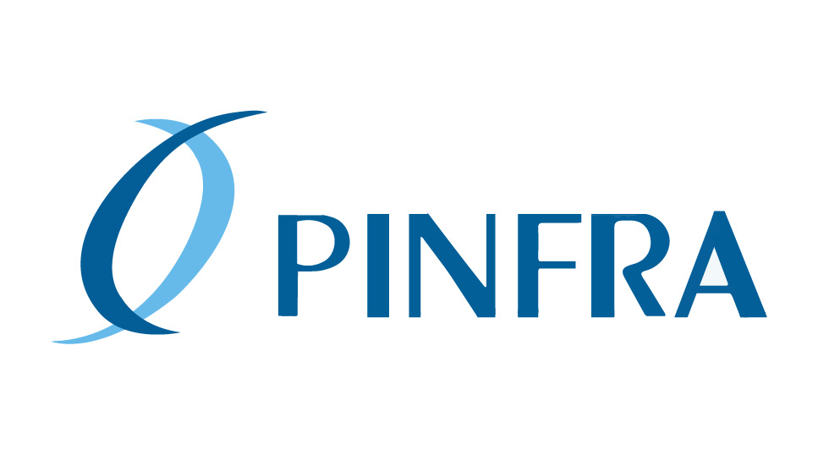





Fund I (AINDACK18) 100% committed
AINDA deployed in Fund I (~US $273MM) of equity in highly profitable assets.
Mty – Nuevo Laredo
Chiapas
Neology
Jaguar
Hokchi
EqV: ~US$348MM
AINDA Ticket: US$46.7MM
La Gloria – San Fernando Highway
EqV: ~US$113MM
AINDA Ticket: US$30MM
Tuxtla -San Cristóbal expansion
Arriaga-Ocozocoautla modernization
EqV: ~US$123MM
AINDA Ticket: US$38MM
Electronic toll technology,
mobility and security
EqV: ~US$198MM
AINDA Ticket: US$37.6MM
3 solar Parks in Chihuahua with an installed capacity of 216MW
EqV: ~US$1,914MM
AINDA Ticket: US$120MM
Shared Production Contract
(14 wells Southeaster Basin)
Investments
Sector: Roads
Sector: Roads
Sector: Mobility
Sector: Renewables
Sector: O&G
Development of adjacent roads
Financing
COVID rebalancing
Parking area for heavy-traffic
Refinancing
Reduction of service interruptions
COVID rebalancing
Enforcement and mobility
LatAm growth
Highway operation
Gasoline
PPA extension
Capacity extension
Optimization/ batteries &AI
Financing
Financing
Optimization of the oil field
Upsides
Leader in the construction and operation of civil works and building infrastructures
Global manager with +US$12Bn of capital in public and private funds
Partners
One of the leading concession operating companies in Mexico, with 21 concessions and a market cap of ~US$3Bn
Leader in hydrocarbon production with presence in Argentina, Bolivia and Mexico
Leaders in technology for mobility, electronic tolls, safety, security and payment solutions
China Railway Construction Corp.
is a leader in the design and construction of railways, highways, bridges, tunnels, and mass urban transportation
Local investor with +US$550MM in 6 investment platforms
Leader in exploration and production of oil and natural gas, it operates in 11 countries in Europe, the Middle East, Africa and Latin America

Slide 17
Concesionaria Monterrey-NL
AINDA invested to build and operate the Monterrey - Nuevo Laredo Highway, in the section "La Gloria - San Fernando " (A2 and A4S), as well as reconditioning, conserving and maintaining the free federal highway.
General characteristics
Structure
Federal concession valid for 30 years until 2047 for the construction, exploitation, conservation and maintenance of the “La Gloria – San Fernando” Highway, 49.5 kms long, as well as the construction, conservation and maintenance of the free federal highway.
The section corresponding to the project starts in La Gloria-junction, km 145 in the estate of Nuevo Leon, until the Ex Garita-junction, km 194 in the estate of Tamaulipas.
Concesionaria Mty - NL
Project Value
Upsides
It is part of the “USMCA freight corridor”, which registers an important exchange of goods between U.S.A. and Canada.
It betters the communication in the Nuevo Laredo corridor.
Because of its geographical location, infrastructure developed in Nuevo Laredo has the most relevant competitive advantage in the international trade of land cargo and border crossings of people.
Reduction in travel time and increase in user safety (reduction in accidents).
 | Description
Construction of splits | (i) Extend the La Gloria-San Fernando highway by 4.5 km. (ii) Build the section from La Gloria to the junction with the Anahuac highway and modernize and operate section 1 of the Anahuac - Puente Colombia highway.
Financing | Hiring financing to optimize the capital structure.
Covid Rebalancing | Request an extension of the concession term, a toll increase, or a combination of these to the SCT to recover losses, in accordance with the right of the concession title.
Heavy traffic service stop | Build and operate a service stop for cargo transportation between toll plazas.

Slide 18
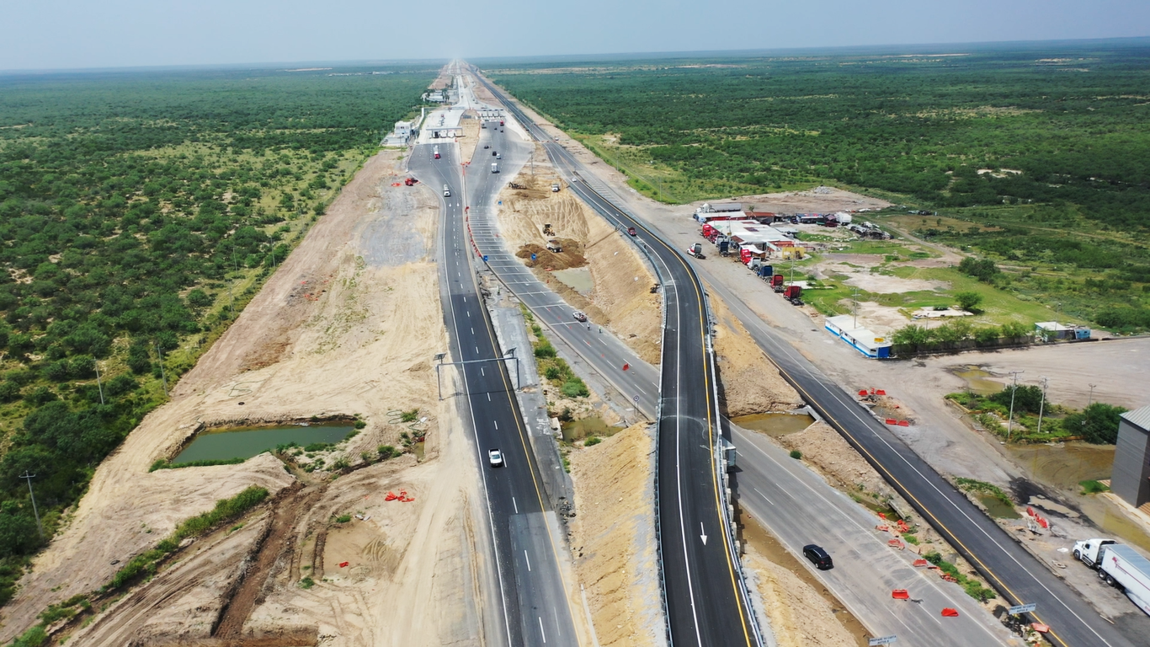
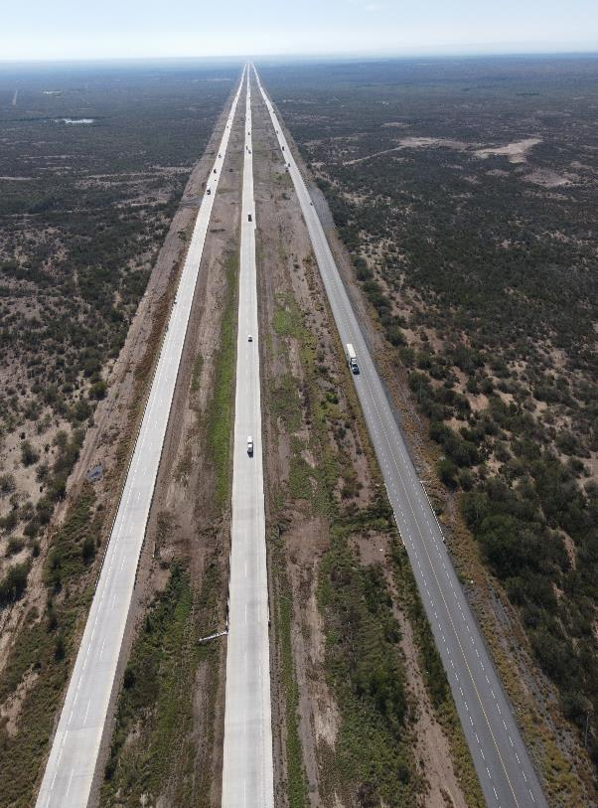
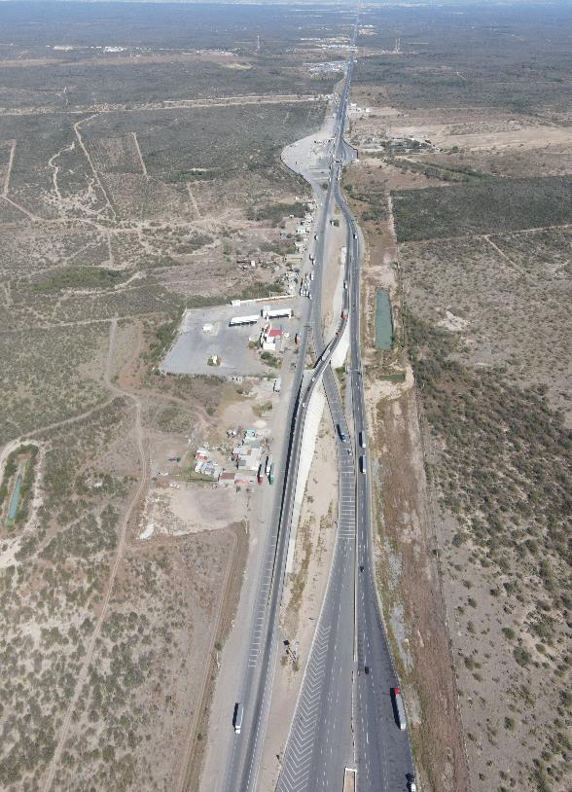
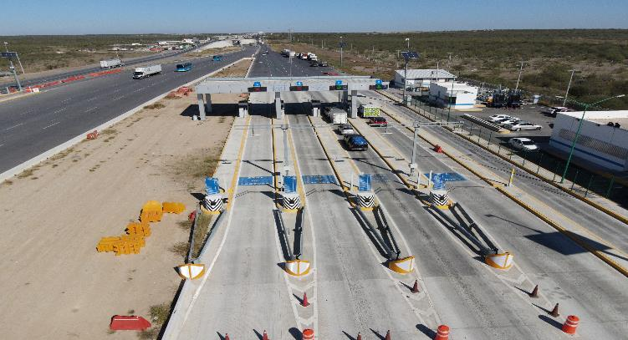
Concesionaria Monterrey-NL
18

Slide 19


Concesionaria Autopistas del Sureste
AINDA acquired a stake in Concesionaria Autopistas del Sureste ("CAS"), a subsidiary of Grupo Aldesa. The SCT granted CAS the concession for sections of the Tuxtla Gutiérrez-San Cristóbal de las Casas and Arriaga-Ocozocoautla highways.
General characteristics
Structure
Acquisition of 49% - 35.37%¹ of Concesionaria Autopistas del Sureste (CAS), a subsidiary of Grupo Aldesa. Concession granted for 50 years (ending in October 2057), which allows the exploitation, conservation, maintenance and modernization of the Tuxtla Gutiérrez-San Cristóbal de las Casas and Arriaga-Ocozocoautla highways, in the state of Chiapas.
The project considers the expansion to three lanes in 29 km of the Tuxtla Gutiérrez-San Cristóbal de las Casas highway and the modernization of a conflictive section of one km in the Arriaga - Ocozocoautla.
Project Value
Upsides
The highways connect the main cities in Chiapas, the center of Mexico with the coast of Chiapas and provide the main access route to Central America.
The project has generated an increase in the consumption of local goods and services, such as the hiring of local suppliers with labor contracts, rental of machinery and provision of services.
Regarding ESG, in 2022 CAS got certified under the GRESB methodology, where it obtained a rating of 96/100, which positioned it as 1st in highway assets in LatAm.
 | Description
Refinancing | Optimization of the capital structure under a refinancing with better rates and commissions
Seizure of toll booths and road blockades | Compensation of income lost due to the seizure of toll booths and road blockades charged to the Contingency Fund established in the Concession Title
COVID Rebalancing | Enter the SCT a request of income lost due to the COVID19 pandemic through the Contingency/rebalancing fund
Final stake

Slide 20
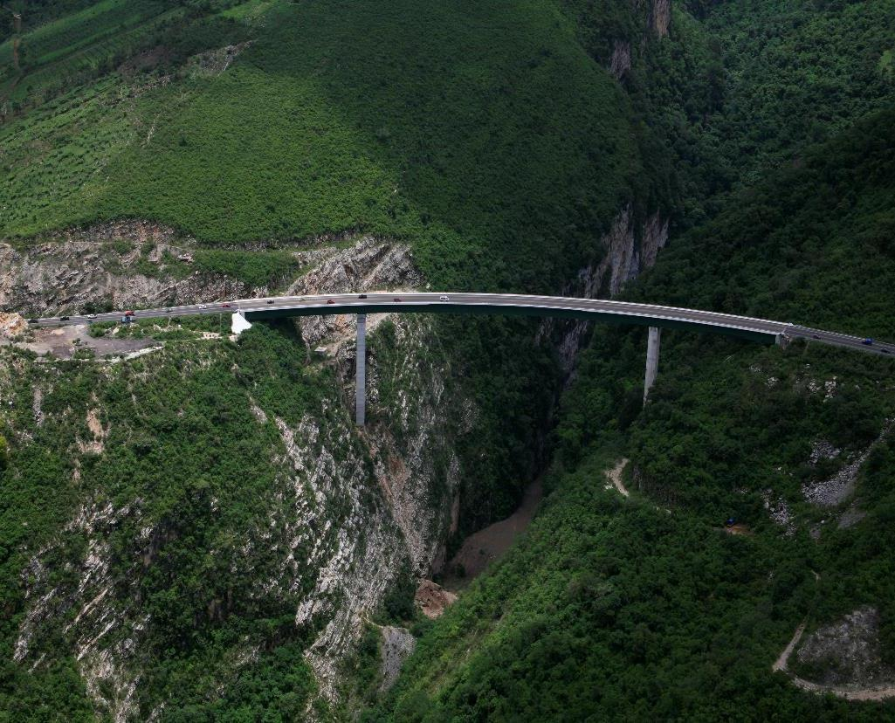
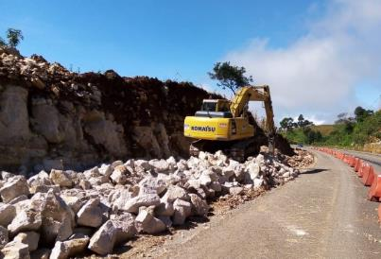
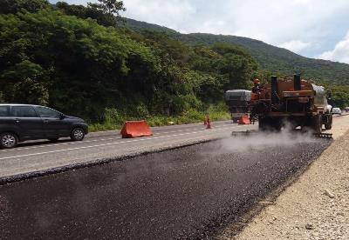
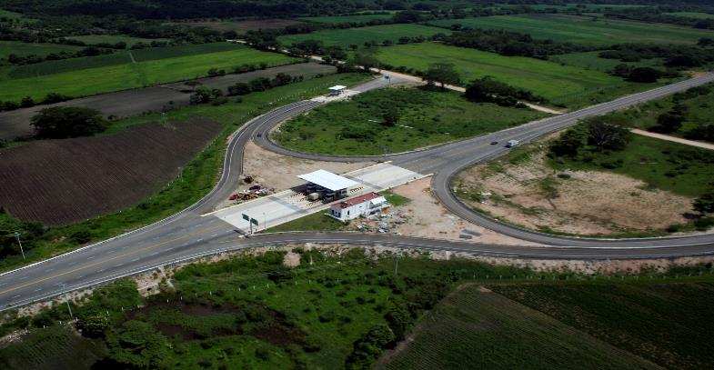
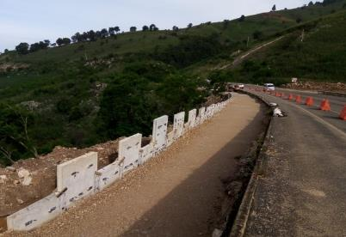
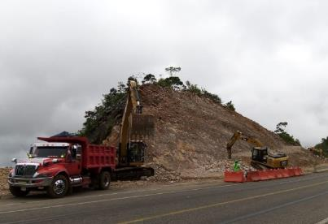
Concesionaria Autopistas del Sureste
20

Slide 21

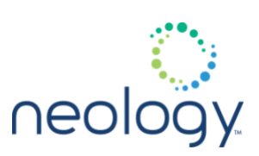

Neology
AINDA made an investment in Neology Latam, a subsidiary of Neology Inc, leader in electronic toll technology, mobility and compliance with the legal framework associated with vehicles.
General characteristics
Structure
Financial stake in the capital of Neology Latam, a subsidiary of Neology Inc., leader in electronic toll technology, mobility and compliance with the legal framework associated with vehicles.
Installation and maintenance of the infrastructure associated with the electronic toll lanes.
Supplier of specialized equipment to third parties for electronic toll lanes.
Payment processing for road users through PASE
Inc
Latam
Project Value
Upsides
Security solutions (“enforcement”) for state agencies and corporations that allow increasing the effectiveness of security by reducing transportation times and pollutant emissions.
Electronic toll mobility solutions with the highest level of technology.
Presence throughout Latin America, that will continue to expand and deepen, where the needs for improvements in road efficiency and safety are essential.
 | Description
Enforcement and mobility | Offer solutions to security and urban mobility corporations
LatAm growth | Expand the scope of the electronic toll business in LatAm
Gasoline | Incentivize the use of TAG as a payment method for fuel

Slide 22

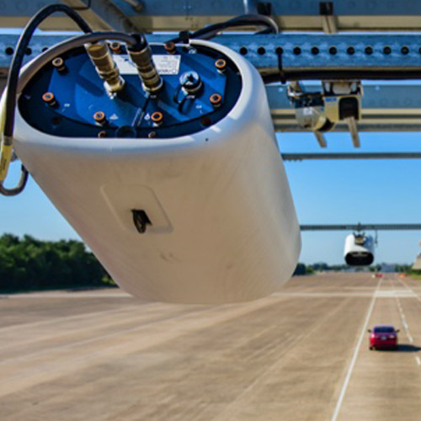
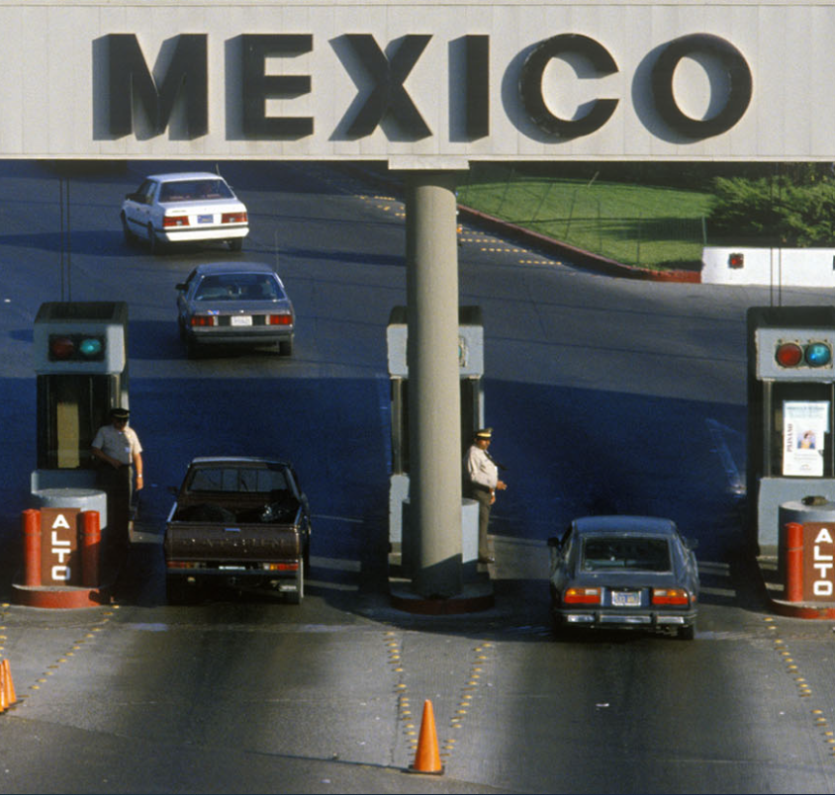


Neology
22

Slide 23


Jaguar
AINDA acquired a stake in a portfolio of 3 solar projects with a capacity of 216 MWp in operation, in partnership with InfraRed and Invex Infraestructura.
General characteristics
Structure
Acquisition of a minority percentage of the Jaguar Solar Portfolio of 216 MWp.
Long-term PPA (2032) with Ammper Suministrador, rated (AA-mx), subsidiary of Grupo Invex for 100% of the energy.
The assets operate under the Electricity Industry Law.
Park: | Ahumadas | Torreoncitos | Rancho el Trece
Location | Villa Ahumada, Chihuahua | Jiménez, Chihuahua | Camarago, Chihuahua
Size | 144 MWp | 36 MWp | 36 MWp
COD: | July 2019 | March 2018 | April 2018
Jaguar Solar
Upsides
 | Description
Optimization of the PPA | Extend the term of the contract
Financing | Optimize the capital structure by exploring different financing schemes
Optimization / batteries & AI | Reduce curtailment potential and take advantage of high PMLs with the use of AI and battery system
Capacity expansion | Expand and take advantage of the land and substation space to install up to an additional 72 MW
Project Value
State-of-the-art clean energy generation in an area of ​​the country with abundant solar resources, with demand and transmission capacity.
Energy transition of the country's generation matrix.

Slide 24
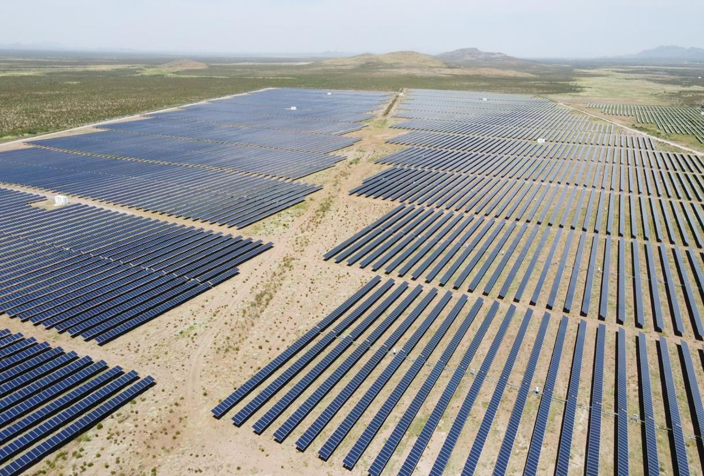
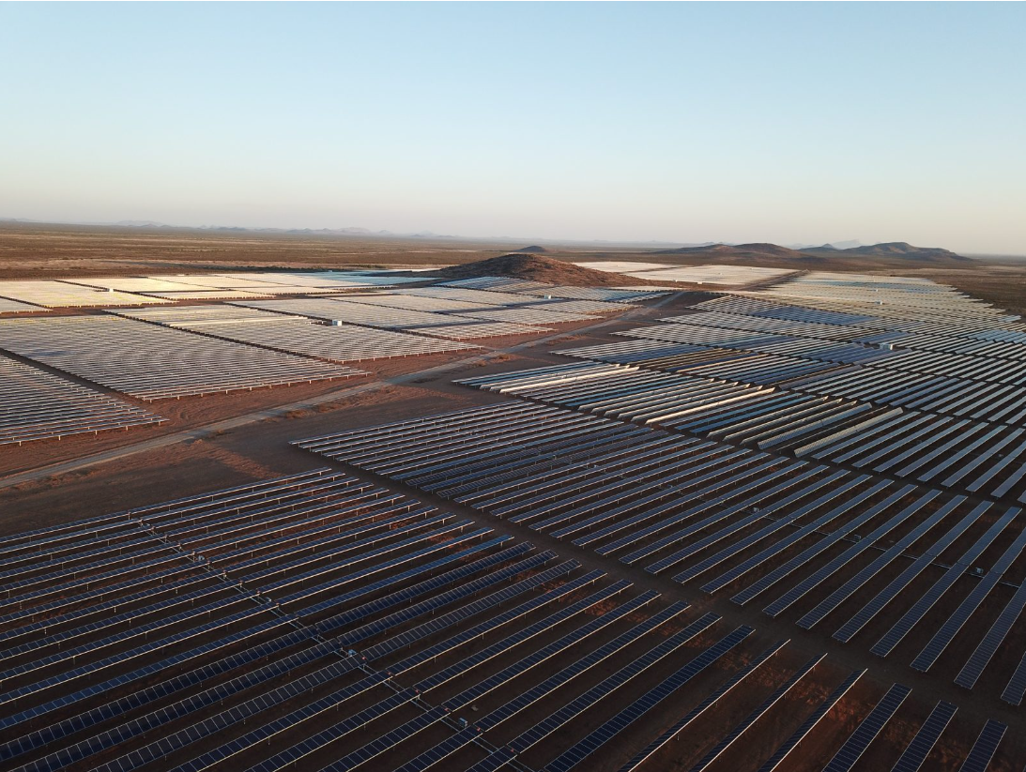
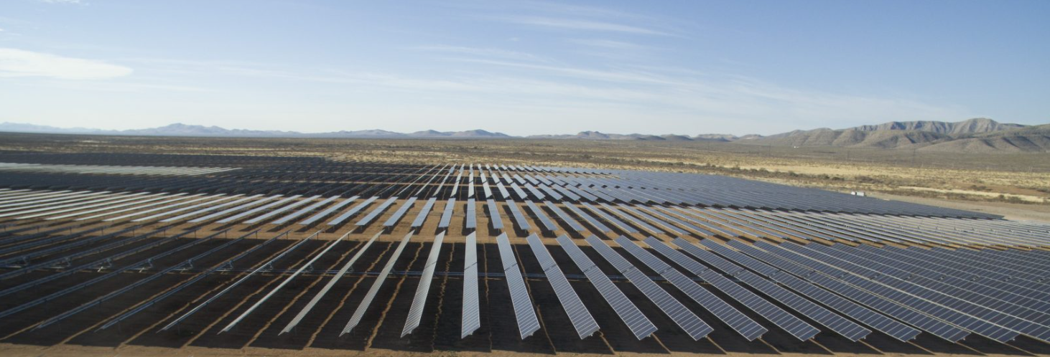
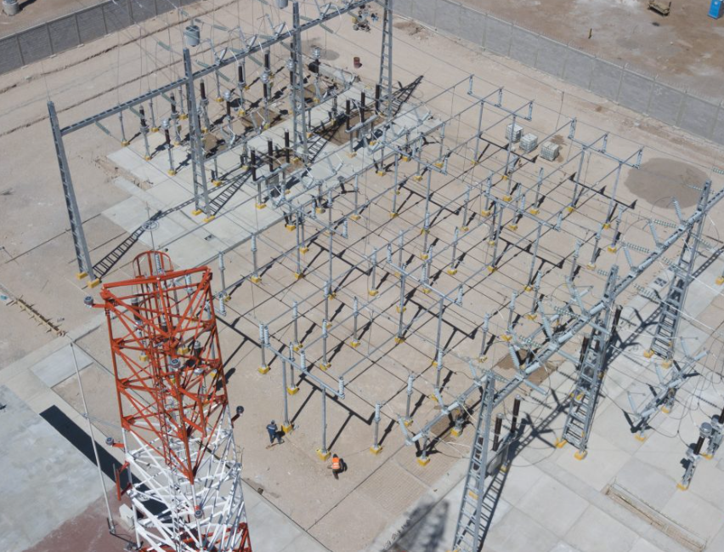
Jaguar
24

Slide 25



Hokchi
AINDA acquired a minority interest in the Production Sharing Contract (“PSC”) for the Hokchi Field, awarded to Hokchi Energy, a subsidiary of Panamerican Energy.
General characteristics
Structure
Production shared contract granted to the Consortium in 2016 by the National Hydrocarbons Commission with a duration of 30 years.
Field located in shallow waters in the Cuenca Sureste, with an area of ​​40km2.
The development plan consists of 7 producing wells and 7 injection wells; the on-shore and off-shore infrastructure are 100% operational.
It is connected through the "Escribano" to the Dos Bocas Maritime Terminal; 27 km away and the “Palomas” gas processing center.
Production as of Mar’23 of ~26,300 boed.
AEI Infraestructura I
S.A. de C.V.
AEI Hidrocarburos
S.A de CV
E&P
Hidrocarburos
PSC Contract
Project Value
Upsides
Located in one of the most productive areas in the Gulf of Mexico.
Attractive technical indicators; low-risk and low geological complexity reservoir.
Crude quality of 29° API, with commercial agreements with PEMEX.
Reserves certified by Ryder Scott and RPS Group, with an estimated recovery factor of 37% to 43%.
 | Description
Financing | Hire financing to exercise the purchase option for the additional 4.4% stake or optimize the capital structure
Reservoir optimization | Evaluate the implementation of tertiary recovery, whose main techniques include gas injection, chemical flooding and thermal methods

Slide 26
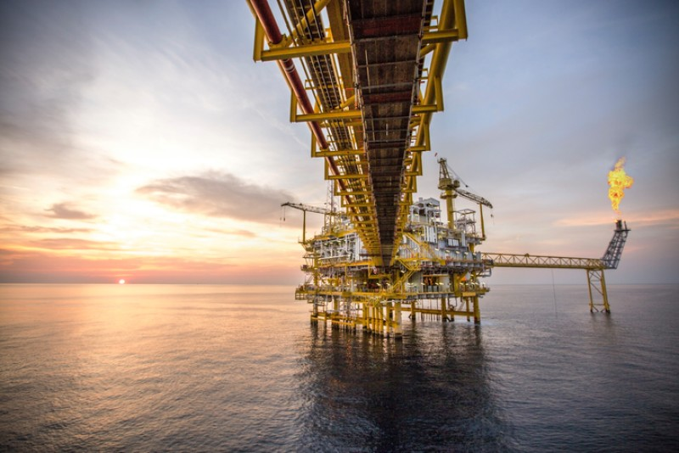
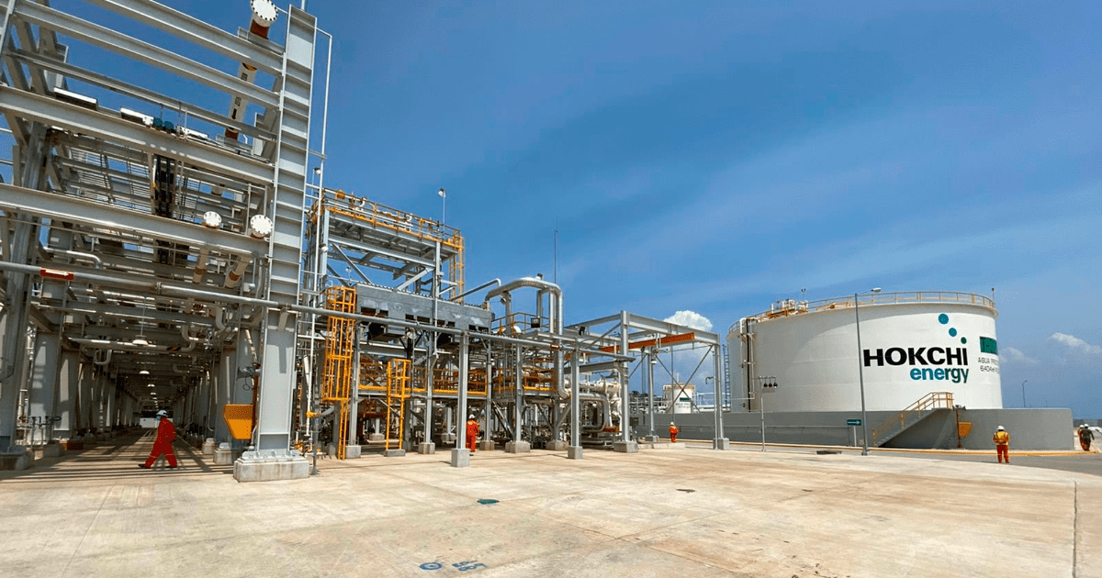
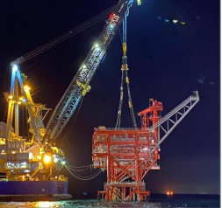
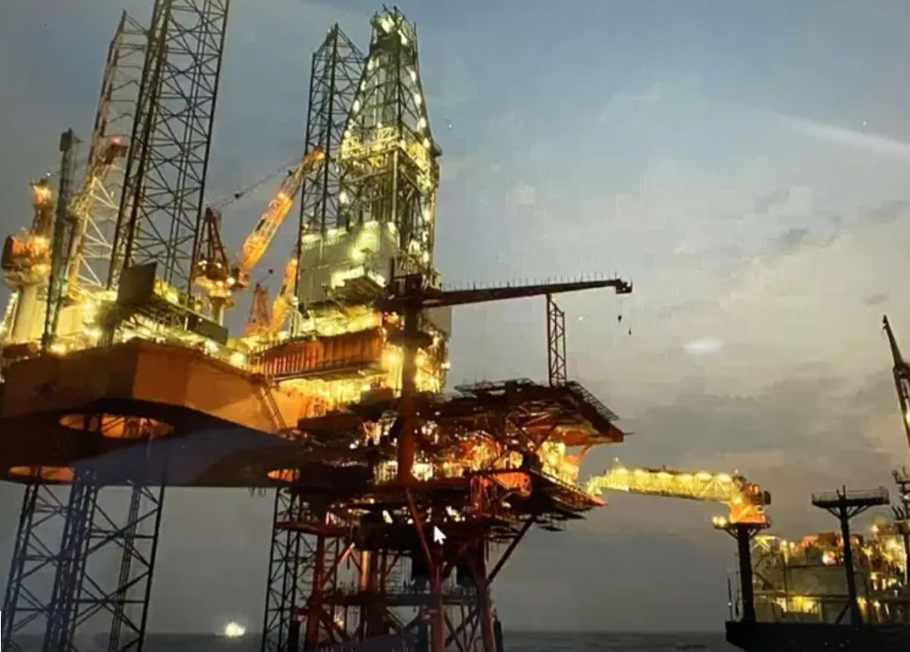
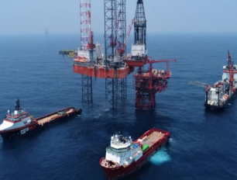
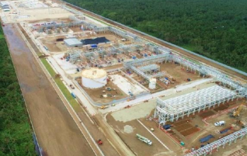
Hokchi
26

Slide 27
